Slide 1

Airline Passenger Satisfaction
By: Patricia Miranda

Slide 2
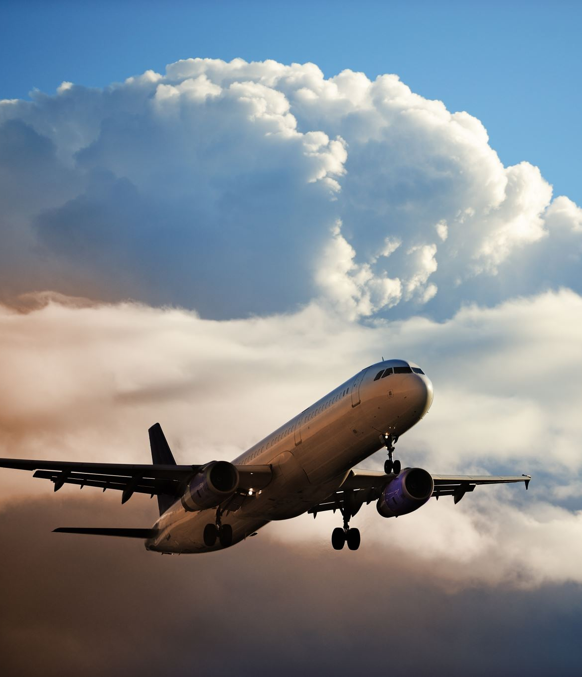
The Problem:
How to determine Airline Passenger Satisfaction?

Slide 3

The Solution:
Identify determining factors for passenger satisfaction during airport and flight experience with predictive models.

Slide 4
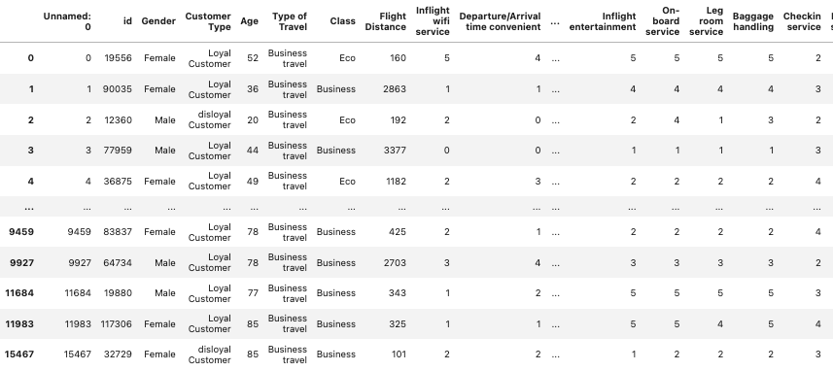
The Dataset:
Airline Data: https://www.kaggle.com/datasets/teejmahal20/airline-passenger-satisfaction

Slide 5
Data Wrangling
Analyze data types and identify missing values
Drop rows with null values in column ‘Arrival Delay in Minutes’
Target value: ‘Satisfied or Dissatisfied/Neutral’

Slide 6
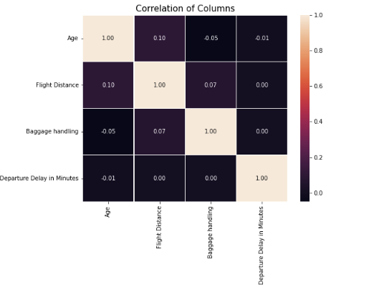
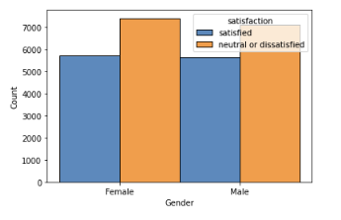
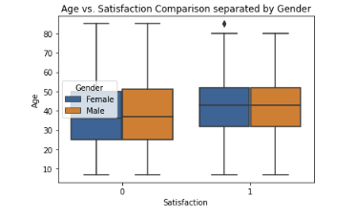
Exploratory Data Analysis:

Slide 7
Models:
Random Forest
LightGBM
KNNClassifier

Slide 8
Takeaways:
LightGBM was the most accurate model
Most features are not important (Only used certain columns for analysis)
Different airlines may have different data with different conclusions

Slide 9

Future Analysis:
Use more data from different airlines, possibly non-anonymous airline
Use other models for prediction
Obtain/use more recent datasets, data is unknown for this dataset.

Slide 10
Questions?

